Slide 1
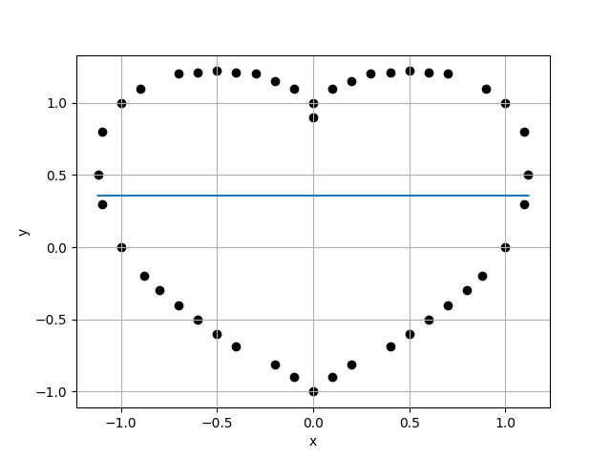
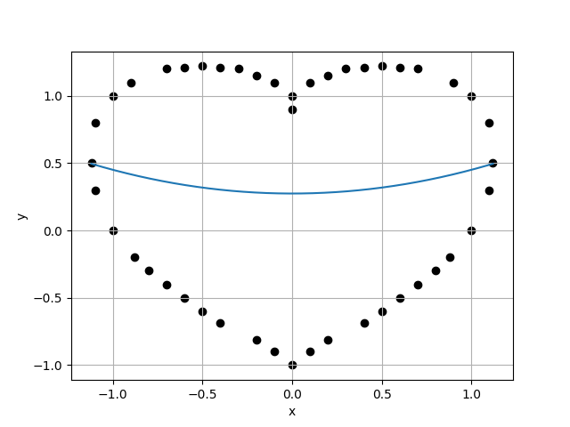
Case 1 :
Case 2 :
f(x) = 3.5733E-01
f(x) = 3.5733E-01 + 3.4387E-17 * x
8.0885E-01
8.1820E-01
9.8857E-01
9.9269E-01
Case 3 :
f(x) = 2.7428E-01 + 3.8385E-17 * x + 1.7615E-01 * x^2
Case 4 :
f(x) = 2.7428E-01 + 6.5831E-16 * x + 1.7615E-01 * x^2 + -7.2317E-16 * x^3
8.2423E-01
8.3422E-01
9.8802E-01
9.8882E-01

Slide 2
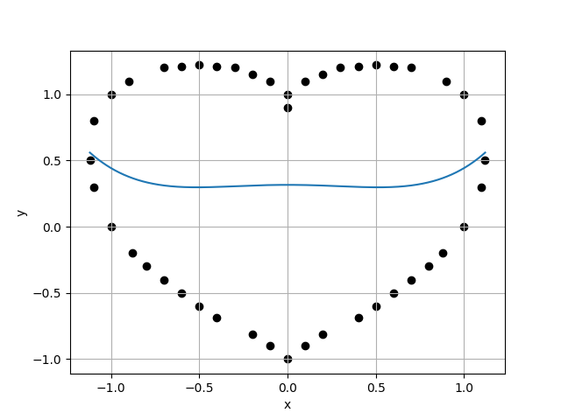
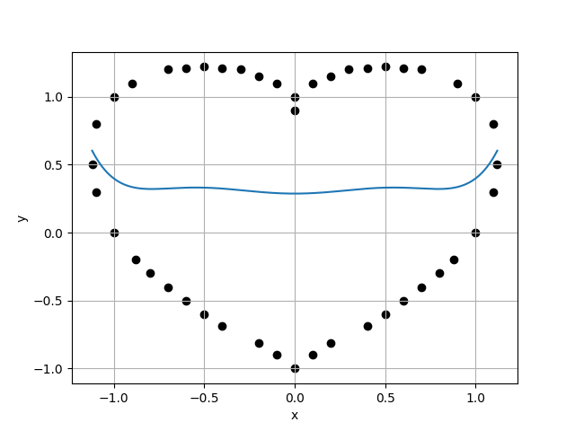
Case 5 :
Case 6 :
f(x) = 3.1567E-01 + 4.8899E-16 * x + -1.4008E-01 * x^2 + -5.5060E-16 * x^3 + 2.6649E-01 * x^4
f(x) = 3.1567E-01 + 3.8693E-15 * x + -1.4008E-01 * x^2 + -1.2292E-14 * x^3 + 2.6649E-01 * x^4 + 7.7559E-15 * x^5
8.4365E-01
8.5440E-01
9.8742E-01
9.8772E-01
Case 7 :
f(x) = 2.8707E-01 + 3.5654E-15 * x + 3.5471E-01 * x^2 + -1.0642E-14 * x^3 + -8.7744E-01 * x^4 + 6.5116E-15 * x^5 + 6.3402E-01 * x^6
Case 8 :
f(x) = 2.8707E-01 + -1.1195E-14 * x + 3.5471E-01 * x^2 + 8.7276E-14 * x^3 + -8.7744E-01 * x^4 + -1.5455E-13 * x^5 + 6.3402E-01 * x^6 + 7.4787E-14 * x^7
8.6502E-01
8.7664E-01
9.8675E-01
9.9404E-01

Slide 3
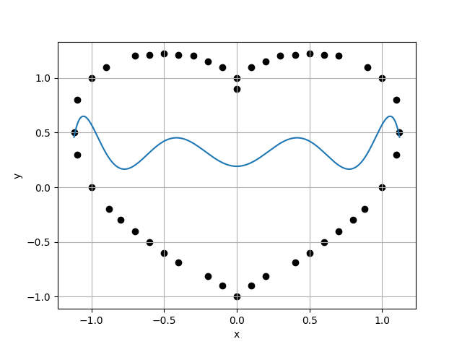
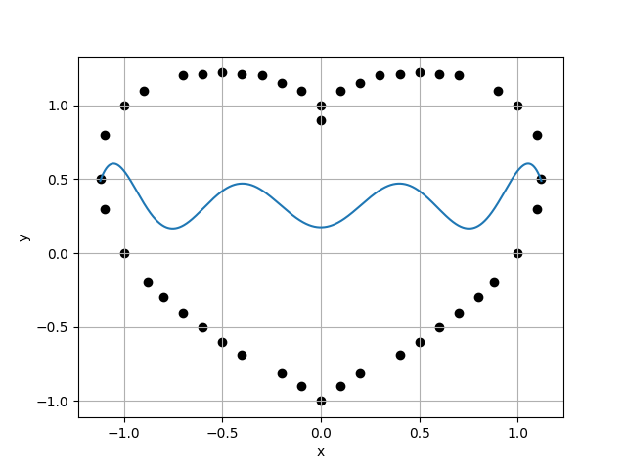
Case 9 :
Case 10 :
f(x) = 1.9164E-01 + -9.7532E-13 * x + 3.5211E+00 * x^2 + 6.2384E-12 * x^3 + -1.4746E+01 * x^4 + -1.0011E-11 * x^5 + 1.9281E+01 * x^6 + 4.5711E-12 * x^7 + -7.6761E+00 * x^8
f(x) = 1.9164E-01 + -5.8532E-12 * x + 3.5211E+00 * x^2 + 6.1083E-11 * x^3 + -1.4746E+01 * x^4 + -1.7709E-10 * x^5 + 1.9281E+01 * x^6 + 1.9050E-10 * x^7 + -7.6761E+00 * x^8 + -6.8131E-11 * x^9
8.8189E-01
8.9440E-01
9.8601E-01
9.8586E-01
Case 11 :
f(x) = 1.7475E-01 + -9.3200E-12 * x + 4.4115E+00 * x^2 + 9.5922E-11 * x^3 + -2.0910E+01 * x^4 + -2.7583E-10 * x^5 + 3.3884E+01 * x^6 + 2.9522E-10 * x^7 + -2.1612E+01 * x^8 + -1.0522E-10 * x^9 + 4.6089E+00 * x^10
Case 12 :
f(x) = 1.7475E-01 + -4.5282E-11 * x + 4.4115E+00 * x^2 + 7.1401E-10 * x^3 + -2.0910E+01 * x^4 + -3.2122E-09 * x^5 + 3.3884E+01 * x^6 + 5.9255E-09 * x^7 + -2.1612E+01 * x^8 + -4.7883E-09 * x^9 + 4.6089E+00 * x^10 + 1.4064E-09 * x^11
9.0723E-01
9.2087E-01
9.8518E-01
9.8475E-01

Slide 4
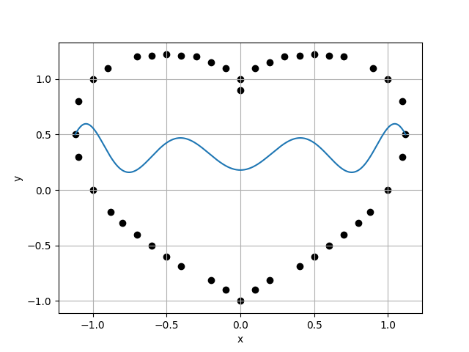
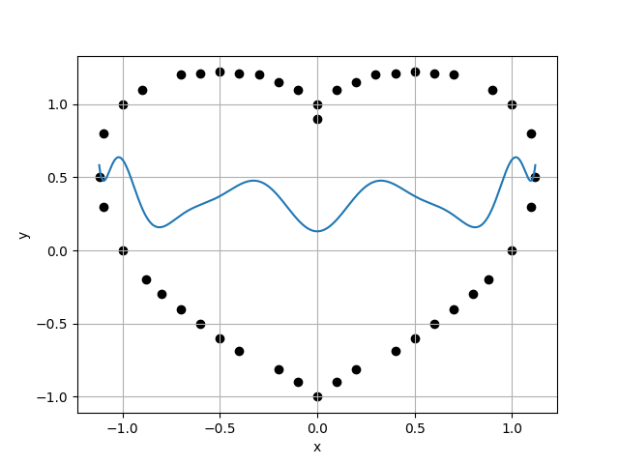
Case 13 :
Case 14 :
f(x) = 1.7962E-01 + 4.7056E-12 * x + 4.0474E+00 * x^2 + -1.0908E-10 * x^3 + -1.7288E+01 * x^4 + 5.9502E-10 * x^5 + 2.0912E+01 * x^6 + -1.2373E-09 * x^7 + -7.9525E-01 * x^8 + 1.0851E-09 * x^9 + -1.0692E+01 * x^10 + -3.3817E-10 * x^11 + 4.1959E+00 * x^12
f(x) = 1.7962E-01 + -4.8171E-12 * x + 4.0474E+00 * x^2 + 1.2506E-10 * x^3 + -1.7288E+01 * x^4 + -9.9289E-10 * x^5 + 2.0912E+01 * x^6 + 3.3223E-09 * x^7 + -7.9525E-01 * x^8 + -5.2277E-09 * x^9 + -1.0692E+01 * x^10 + 3.8321E-09 * x^11 + 4.1959E+00 * x^12 + -1.0546E-09 * x^13
9.3513E-01
9.5009E-01
9.8425E-01
9.8575E-01
Case 15 :
f(x) = 1.3042E-01 + -7.5103E-09 * x + 8.7003E+00 * x^2 + 1.6421E-07 * x^3 + -7.7866E+01 * x^4 + -1.0260E-06 * x^5 + 3.1469E+02 * x^6 + 2.7633E-06 * x^7 + -6.7842E+02 * x^8 + -3.6326E-06 * x^9 + 7.9095E+02 * x^10 + 2.2989E-06 * x^11 + -4.6567E+02 * x^12 + -5.6076E-07 * x^13 + 1.0811E+02 * x^14
Case 16 :
f(x) = 1.3042E-01 + 1.1980E-08 * x + 8.7003E+00 * x^2 + -4.7387E-07 * x^3 + -7.7866E+01 * x^4 + 4.6406E-06 * x^5 + 3.1469E+02 * x^6 + -1.9037E-05 * x^7 + -6.7842E+02 * x^8 + 3.9049E-05 * x^9 + 7.9095E+02 * x^10 + -4.2231E-05 * x^11 + -4.6567E+02 * x^12 + 2.3026E-05 * x^13 + 1.0811E+02 * x^14 + -4.9882E-06 * x^15
9.6383E-01
9.8031E-01
9.8319E-01
9.8983E-01

Slide 5
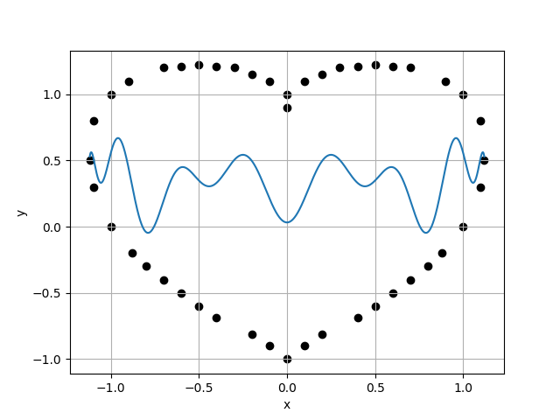

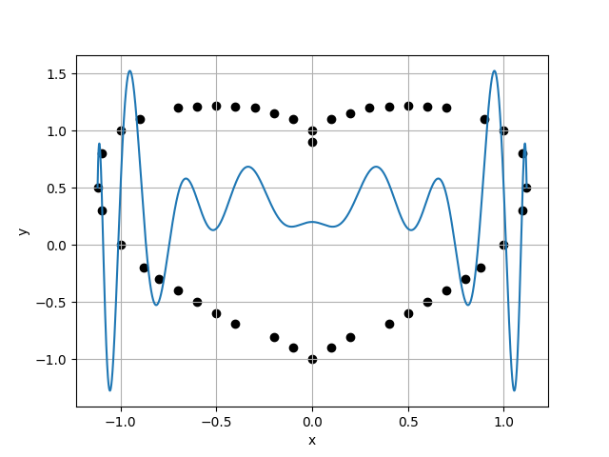

Case 17 :
Case 18 :
f(x) = 3.1977E-02 + 9.6791E-07 * x + 2.1041E+01 * x^2 + -3.1730E-05 * x^3 + -2.9827E+02 * x^4 + 2.8124E-04 * x^5 + 1.7834E+03 * x^6 + -1.0787E-03 * x^7 + -5.4231E+03 * x^8 + 2.1048E-03 * x^9 + 9.0296E+03 * x^10 + -2.1880E-03 * x^11 + -8.3276E+03 * x^12 + 1.1548E-03 * x^13 + 3.9908E+03 * x^14 + -2.4336E-04 * x^15 + -7.7537E+02 * x^16
f(x) = 3.1977E-02 + 1.4601E-05 * x + 2.1041E+01 * x^2 + -6.2435E-04 * x^3 + -2.9827E+02 * x^4 + 7.3220E-03 * x^5 + 1.7834E+03 * x^6 + -3.8125E-02 * x^7 + -5.4231E+03 * x^8 + 1.0463E-01 * x^9 + 9.0296E+03 * x^10 + -1.6191E-01 * x^11 + -8.3277E+03 * x^12 + 1.4188E-01 * x^13 + 3.9908E+03 * x^14 + -6.5625E-02 * x^15 + -7.7537E+02 * x^16 + 1.2441E-02 * x^17
9.9038E-01
1.0086E+00
9.8198E-01
1.0089E+00
Case 19 :
f(x) = 2.0025E-01 + -2.0121E-04 * x + -7.8104E+00 * x^2 + 8.5158E-03 * x^3 + 4.1567E+02 * x^4 + -9.9167E-02 * x^5 + -4.7332E+03 * x^6 + 5.1365E-01 * x^7 + 2.3766E+04 * x^8 + -1.4040E+00 * x^9 + -6.3386E+04 * x^10 + 2.1661E+00 * x^11 + 9.5992E+04 * x^12 + -1.8937E+00 * x^13 + -8.2719E+04 * x^14 + 8.7423E-01 * x^15 + 3.7751E+04 * x^16 + -1.6548E-01 * x^17 + -7.0784E+03 * x^18
Case 20 :
f(x) = 2.0024E-01 + -1.7540E-03 * x + -7.8088E+00 * x^2 + 9.2851E-02 * x^3 + 4.1563E+02 * x^4 + -1.3913E+00 * x^5 + -4.7329E+03 * x^6 + 9.4700E+00 * x^7 + 2.3765E+04 * x^8 + -3.4910E+01 * x^9 + -6.3383E+04 * x^10 + 7.5427E+01 * x^11 + 9.5987E+04 * x^12 + -9.8114E+01 * x^13 + -8.2715E+04 * x^14 + 7.5473E+01 * x^15 + 3.7749E+04 * x^16 + -3.1579E+01 * x^17 + -7.0781E+03 * x^18 + 5.5333E+00 * x^19
9.9967E-01
1.0195E+00
9.8058E-01
9.7996E-01

Slide 6
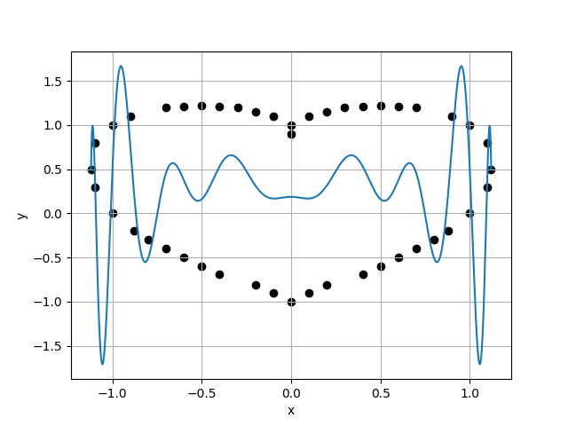
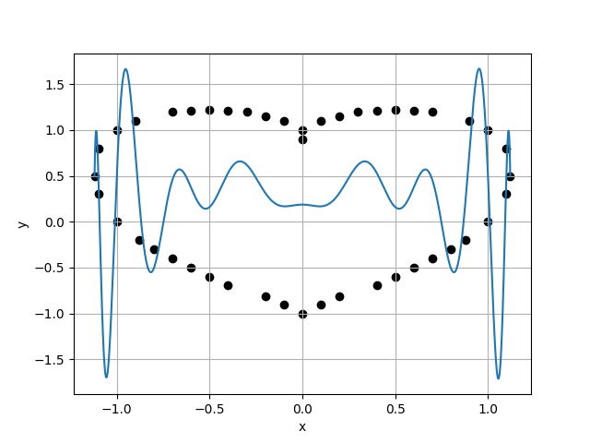
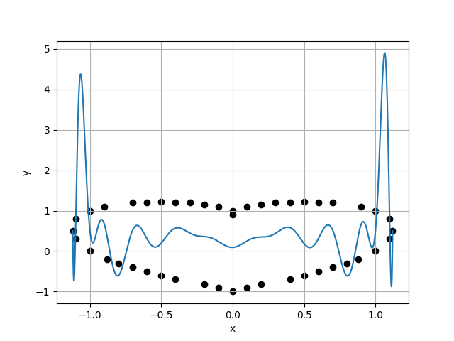
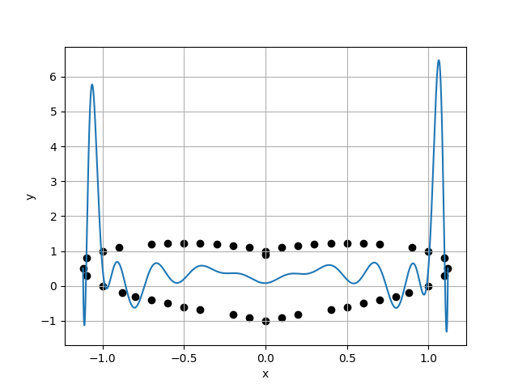
Case 21 :
Case 22 :
f(x) = 1.8688E-01 + -6.0911E-04 * x + -4.6763E+00 * x^2 + 3.2339E-02 * x^3 + 3.1322E+02 * x^4 + -4.8564E-01 * x^5 + -3.5148E+03 * x^6 + 3.3110E+00 * x^7 + 1.6590E+04 * x^8 + -1.2221E+01 * x^9 + -3.9463E+04 * x^10 + 2.6431E+01 * x^11 + 4.7975E+04 * x^12 + -3.4407E+01 * x^13 + -2.3648E+04 * x^14 + 2.6483E+01 * x^15 + -5.7665E+03 * x^16 + -1.1087E+01 * x^17 + 1.0521E+04 * x^18 + 1.9434E+00 * x^19 + -3.0010E+03 * x^20
f(x) = 1.8699E-01 + -3.5398E-03 * x + -4.6997E+00 * x^2 + 2.3910E-01 * x^3 + 3.1397E+02 * x^4 + -4.7296E+00 * x^5 + -3.5236E+03 * x^6 + 4.2777E+01 * x^7 + 1.6641E+04 * x^8 + -2.1163E+02 * x^9 + -3.9632E+04 * x^10 + 6.2523E+02 * x^11 + 4.8310E+04 * x^12 + -1.1490E+03 * x^13 + -2.4059E+04 * x^14 + 1.3226E+03 * x^15 + -5.4655E+03 * x^16 + -9.2550E+02 * x^17 + 1.0399E+04 * x^18 + 3.5944E+02 * x^19 + -2.9804E+03 * x^20 + -5.9339E+01 * x^21
1.0403E+00
1.0627E+00
9.7894E-01
9.5398E-01
Case 23 :
f(x) = 9.2990E-02 + 1.4767E-01 * x + 2.0845E+01 * x^2 + -9.7793E+00 * x^3 + -6.5346E+02 * x^4 + 1.9015E+02 * x^5 + 1.0106E+04 * x^6 + -1.6973E+03 * x^7 + -8.0843E+04 * x^8 + 8.3121E+03 * x^9 + 3.6598E+05 * x^10 + -2.4363E+04 * x^11 + -1.0017E+06 * x^12 + 4.4493E+04 * x^13 + 1.7167E+06 * x^14 + -5.0955E+04 * x^15 + -1.8519E+06 * x^16 + 3.5513E+04 * x^17 + 1.2206E+06 * x^18 + -1.3746E+04 * x^19 + -4.4873E+05 * x^20 + 2.2632E+03 * x^21 + 7.0469E+04 * x^22
Case 24 :
f(x) = 7.9873E-02 + 1.9166E-01 * x + 2.4684E+01 * x^2 + -1.2686E+01 * x^3 + -8.0716E+02 * x^4 + 2.4641E+02 * x^5 + 1.2382E+04 * x^6 + -2.1960E+03 * x^7 + -9.7842E+04 * x^8 + 1.0730E+04 * x^9 + 4.3946E+05 * x^10 + -3.1344E+04 * x^11 + -1.1983E+06 * x^12 + 5.6958E+04 * x^13 + 2.0517E+06 * x^14 + -6.4721E+04 * x^15 + -2.2159E+06 * x^16 + 4.4497E+04 * x^17 + 1.4640E+06 * x^18 + -1.6744E+04 * x^19 + -5.3988E+05 * x^20 + 2.5165E+03 * x^21 + 8.5088E+04 * x^22 + 6.8771E+01 * x^23
1.1140E+00
1.1467E+00
9.7142E-01
1.0339E+00

Slide 7
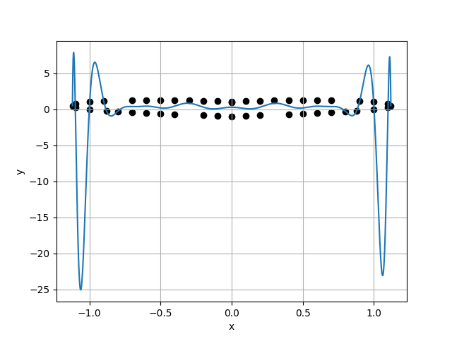
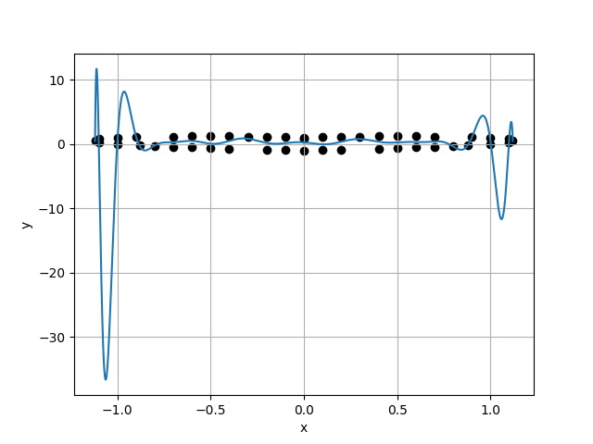
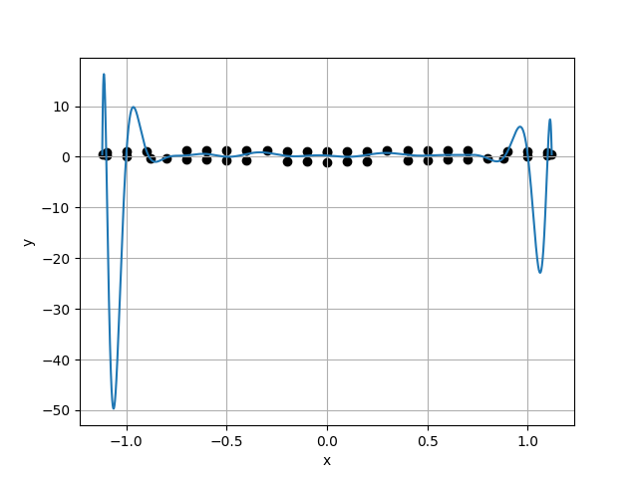
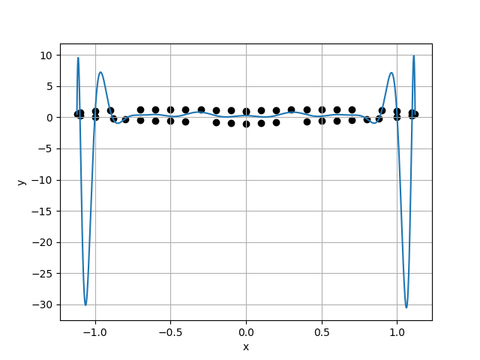
Case 25 :
Case 26 :
f(x) = 2.8323E-01 + -5.3260E-04 * x + -3.3028E+01 * x^2 + 2.1903E+00 * x^3 + 1.4306E+03 * x^4 + -9.7840E+01 * x^5 + -1.9434E+04 * x^6 + 1.4860E+03 * x^7 + 1.2805E+05 * x^8 + -1.1171E+04 * x^9 + -4.7303E+05 * x^10 + 4.8266E+04 * x^11 + 1.0187E+06 * x^12 + -1.2875E+05 * x^13 + -1.1964E+06 * x^14 + 2.1871E+05 * x^15 + 4.4556E+05 * x^16 + -2.3671E+05 * x^17 + 6.5496E+05 * x^18 + 1.5775E+05 * x^19 + -9.6830E+05 * x^20 + -5.8916E+04 * x^21 + 5.0738E+05 * x^22 + 9.4231E+03 * x^23 + -9.8861E+04 * x^24
f(x) = 2.8248E-01 + -2.1350E+00 * x + -3.2637E+01 * x^2 + 1.5932E+02 * x^3 + 1.4094E+03 * x^4 + -3.5058E+03 * x^5 + -1.9038E+04 * x^6 + 3.5051E+04 * x^7 + 1.2442E+05 * x^8 + -1.8968E+05 * x^9 + -4.5405E+05 * x^10 + 5.9901E+05 * x^11 + 9.5707E+05 * x^12 + -1.1089E+06 * x^13 + -1.0670E+06 * x^14 + 1.0634E+06 * x^15 + 2.6653E+05 * x^16 + -1.0304E+05 * x^17 + 8.1697E+05 * x^18 + -9.3414E+05 * x^19 + -1.0605E+06 * x^20 + 1.0388E+06 * x^21 + 5.3731E+05 * x^22 + -4.8468E+05 * x^23 + -1.0309E+05 * x^24 + 8.7467E+04 * x^25
1.1091E+00
1.1432E+00
9.7015E-01
9.6775E-01
Case 27 :
f(x) = 2.5794E-01 + -2.5104E+00 * x + -2.3836E+01 * x^2 + 1.8331E+02 * x^3 + 9.9459E+02 * x^4 + -3.9417E+03 * x^5 + -1.1836E+04 * x^6 + 3.8462E+04 * x^7 + 6.1790E+04 * x^8 + -2.0217E+05 * x^9 + -1.4216E+05 * x^10 + 6.1285E+05 * x^11 + 1.1028E+04 * x^12 + -1.0539E+06 * x^13 + 7.0133E+05 * x^14 + 8.0987E+05 * x^15 + -1.6557E+06 * x^16 + 3.8377E+05 * x^17 + 1.6944E+06 * x^18 + -1.4678E+06 * x^19 + -6.0795E+05 * x^20 + 1.3849E+06 * x^21 + -3.0054E+05 * x^22 + -6.0845E+05 * x^23 + 3.2979E+05 * x^24 + 1.0633E+05 * x^25 + -8.1125E+04 * x^26
Case 28 :
f(x) = 2.7751E-01 + -2.5792E-01 * x + -3.0625E+01 * x^2 + 2.0193E+01 * x^3 + 1.3054E+03 * x^4 + -4.7395E+02 * x^5 + -1.7080E+04 * x^6 + 5.1335E+03 * x^7 + 1.0624E+05 * x^8 + -3.0700E+04 * x^9 + -3.5872E+05 * x^10 + 1.1020E+05 * x^11 + 6.5688E+05 * x^12 + -2.4324E+05 * x^13 + -4.9534E+05 * x^14 + 3.1383E+05 * x^15 + -3.4114E+05 * x^16 + -1.6813E+05 * x^17 + 1.0266E+06 * x^18 + -1.3000E+05 * x^19 + -7.7968E+05 * x^20 + 3.0361E+05 * x^21 + 1.4559E+05 * x^22 + -2.3554E+05 * x^23 + 9.1588E+04 * x^24 + 8.8971E+04 * x^25 + -3.6226E+04 * x^26 + -1.3672E+04 * x^27
1.1813E+00
1.2049E+00
9.8045E-01
9.7567E-01

Slide 8
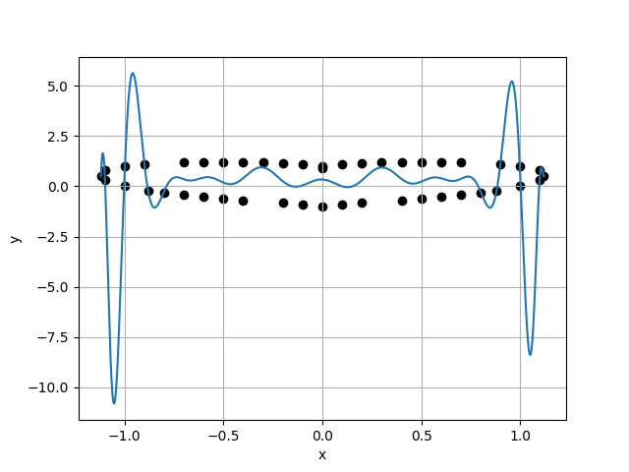
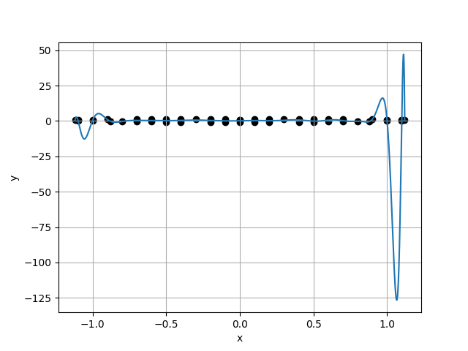
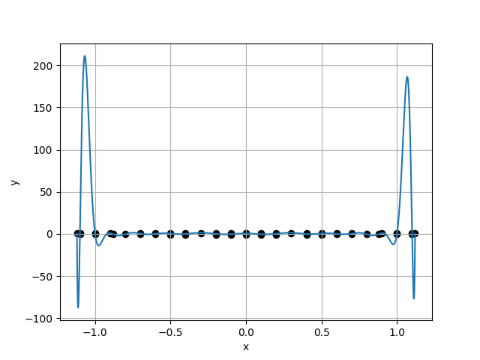
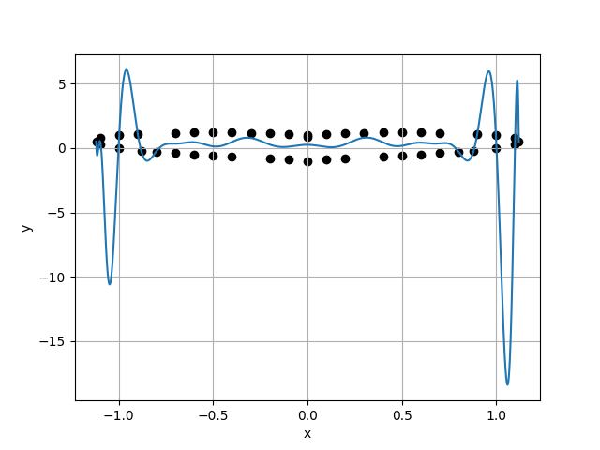
Case 29 :
Case 30 :
f(x) = 3.4170E-01 + -5.5937E-01 * x + -5.0203E+01 * x^2 + 3.9541E+01 * x^3 + 2.1147E+03 * x^4 + -8.2205E+02 * x^5 + -2.9340E+04 * x^6 + 7.7244E+03 * x^7 + 1.9828E+05 * x^8 + -3.8441E+04 * x^9 + -7.4495E+05 * x^10 + 1.0457E+05 * x^11 + 1.5944E+06 * x^12 + -1.2868E+05 * x^13 + -1.7378E+06 * x^14 + -7.4910E+04 * x^15 + 2.7395E+05 * x^16 + 5.3845E+05 * x^17 + 1.4011E+06 * x^18 + -9.1053E+05 * x^19 + -1.0262E+06 * x^20 + 8.3340E+05 * x^21 + -6.7643E+05 * x^22 + -4.4452E+05 * x^23 + 1.2919E+06 * x^24 + 1.2972E+05 * x^25 + -6.6957E+05 * x^26 + -1.5987E+04 * x^27 + 1.2258E+05 * x^28
f(x) = 1.5346E-01 + 2.0380E+00 * x + 8.0014E+00 * x^2 + -1.1311E+02 * x^3 + -3.1653E+02 * x^4 + 1.4679E+03 * x^5 + 7.8907E+03 * x^6 + -2.9598E+03 * x^7 + -8.4636E+04 * x^8 + -6.0848E+04 * x^9 + 4.5998E+05 * x^10 + 5.0701E+05 * x^11 + -1.3888E+06 * x^12 + -1.7933E+06 * x^13 + 2.3292E+06 * x^14 + 3.3843E+06 * x^15 + -1.8048E+06 * x^16 + -3.2805E+06 * x^17 + -2.2048E+05 * x^18 + 9.5288E+05 * x^19 + 1.2215E+06 * x^20 + 7.5226E+05 * x^21 + -6.0171E+04 * x^22 + -5.0653E+04 * x^23 + -1.0601E+06 * x^24 + -9.7840E+05 * x^25 + 7.7631E+05 * x^26 + 7.3721E+05 * x^27 + -1.7546E+05 * x^28 + -1.6827E+05 * x^29
1.2349E+00
1.3210E+00
9.3479E-01
9.7338E-01
Case 31 :
f(x) = 6.4646E-01 + -1.1113E+00 * x + -1.4477E+02 * x^2 + 9.7222E+01 * x^3 + 6.0218E+03 * x^4 + -2.5148E+03 * x^5 + -8.7560E+04 * x^6 + 2.9460E+04 * x^7 + 6.1988E+05 * x^8 + -1.8771E+05 * x^9 + -2.3997E+06 * x^10 + 7.0781E+05 * x^11 + 5.1230E+06 * x^12 + -1.6172E+06 * x^13 + -5.0834E+06 * x^14 + 2.1286E+06 * x^15 + -6.3498E+05 * x^16 + -1.1839E+06 * x^17 + 5.7914E+06 * x^18 + -6.3156E+05 * x^19 + -2.4702E+06 * x^20 + 1.3148E+06 * x^21 + -3.4397E+06 * x^22 + -4.7064E+05 * x^23 + 2.5042E+06 * x^24 + -3.1775E+05 * x^25 + 1.4135E+06 * x^26 + 2.9845E+05 * x^27 + -1.8209E+06 * x^28 + -6.7979E+04 * x^29 + 4.7864E+05 * x^30
Case 32 :
f(x) = 2.6200E-01 + -1.4253E-01 * x + -2.5549E+01 * x^2 + 3.3639E+00 * x^3 + 1.0732E+03 * x^4 + 1.3660E+02 * x^5 + -1.3012E+04 * x^6 + -4.0898E+03 * x^7 + 6.9476E+04 * x^8 + 4.2245E+04 * x^9 + -1.6458E+05 * x^10 + -2.2541E+05 * x^11 + 2.7090E+04 * x^12 + 6.8905E+05 * x^13 + 7.5001E+05 * x^14 + -1.1954E+06 * x^15 + -1.6820E+06 * x^16 + 9.3211E+05 * x^17 + 1.3593E+06 * x^18 + 3.6970E+05 * x^19 + 9.6765E+04 * x^20 + -1.3264E+06 * x^21 + -6.0986E+05 * x^22 + 6.4031E+05 * x^23 + -2.6996E+05 * x^24 + 6.8257E+05 * x^25 + 8.2222E+05 * x^26 + -1.0024E+06 * x^27 + -4.8028E+05 * x^28 + 4.8289E+05 * x^29 + 9.3803E+04 * x^30 + -8.5375E+04 * x^31
1.3572E+00
1.3793E+00
9.8396E-01
9.7046E-01

Slide 9
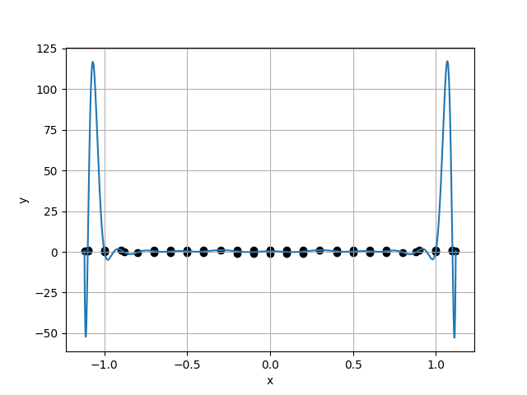
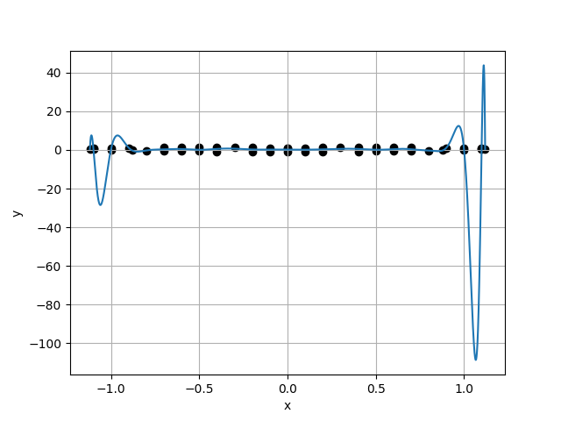
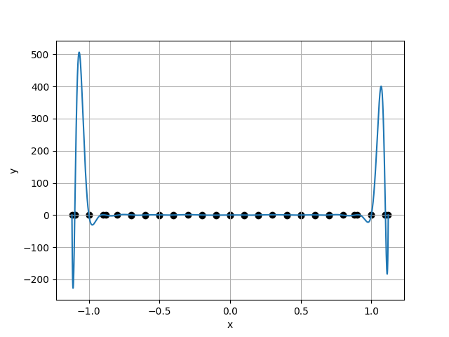
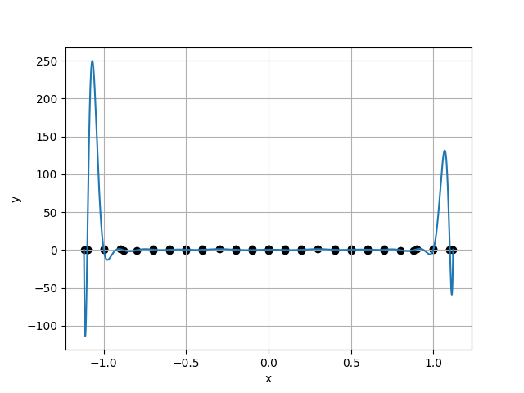
Case 33 :
Case 34 :
f(x) = 4.1323E-01 + 5.7559E-01 * x + -7.1745E+01 * x^2 + -4.0851E+01 * x^3 + 2.9708E+03 * x^4 + 8.5378E+02 * x^5 + -4.1361E+04 * x^6 + -8.0949E+03 * x^7 + 2.7798E+05 * x^8 + 4.1113E+04 * x^9 + -1.0181E+06 * x^10 + -1.1860E+05 * x^11 + 2.0580E+06 * x^12 + 1.8675E+05 * x^13 + -2.0034E+06 * x^14 + -1.1143E+05 * x^15 + 1.9793E+05 * x^16 + -9.8922E+04 * x^17 + 9.7907E+05 * x^18 + 1.8657E+05 * x^19 + 3.9885E+04 * x^20 + -4.5278E+04 * x^21 + -6.5025E+05 * x^22 + -6.5118E+04 * x^23 + -1.7494E+05 * x^24 + -2.3501E+03 * x^25 + 1.1034E+04 * x^26 + 7.3898E+04 * x^27 + 9.4386E+05 * x^28 + -4.9707E+04 * x^29 + -8.3518E+05 * x^30 + 1.0366E+04 * x^31 + 2.1258E+05 * x^32
f(x) = 1.8642E-01 + -1.0346E+00 * x + -3.4449E+00 * x^2 + 8.4432E+01 * x^3 + 2.0045E+02 * x^4 + -2.0491E+03 * x^5 + -5.8614E+02 * x^6 + 2.2495E+04 * x^7 + -1.6167E+04 * x^8 + -1.3242E+05 * x^9 + 1.5245E+05 * x^10 + 4.4709E+05 * x^11 + -5.9817E+05 * x^12 + -8.5638E+05 * x^13 + 1.2707E+06 * x^14 + 7.8572E+05 * x^15 + -1.5302E+06 * x^16 + 3.5296E+04 * x^17 + 1.0030E+06 * x^18 + -6.6642E+05 * x^19 + -3.5697E+05 * x^20 + 3.5677E+05 * x^21 + 2.0861E+05 * x^22 + -1.5063E+04 * x^23 + -2.8958E+05 * x^24 + 2.8029E+05 * x^25 + 3.2529E+05 * x^26 + -3.6175E+05 * x^27 + -3.0508E+05 * x^28 + 3.3209E+04 * x^29 + 1.7910E+05 * x^30 + 1.1341E+05 * x^31 + -4.2654E+04 * x^32 + -4.0283E+04 * x^33
1.4213E+00
1.5174E+00
9.3664E-01
9.7114E-01
Case 35 :
f(x) = 4.7471E-01 + -4.1395E-01 * x + -8.9425E+01 * x^2 + 5.6192E+01 * x^3 + 3.5899E+03 * x^4 + -1.9159E+03 * x^5 + -4.7806E+04 * x^6 + 2.6922E+04 * x^7 + 2.9420E+05 * x^8 + -1.9500E+05 * x^9 + -8.9457E+05 * x^10 + 8.0484E+05 * x^11 + 1.0684E+06 * x^12 + -1.9483E+06 * x^13 + 9.2640E+05 * x^14 + 2.6132E+06 * x^15 + -4.0669E+06 * x^16 + -1.3050E+06 * x^17 + 3.8815E+06 * x^18 + -1.2042E+06 * x^19 + -1.1260E+06 * x^20 + 2.1946E+06 * x^21 + 1.4060E+06 * x^22 + -1.3467E+06 * x^23 + -2.4852E+06 * x^24 + 7.1597E+05 * x^25 + -5.8013E+04 * x^26 + -7.0286E+05 * x^27 + 1.7287E+06 * x^28 + 4.6237E+05 * x^29 + -7.5381E+04 * x^30 + -1.1709E+05 * x^31 + -8.7143E+05 * x^32 + 3.1583E+03 * x^33 + 3.1667E+05 * x^34
Case 36 :
f(x) = 4.5184E-01 + 1.0764E-01 * x + -8.3941E+01 * x^2 + -2.5001E+00 * x^3 + 3.4807E+03 * x^4 + -7.2129E+01 * x^5 + -4.9074E+04 * x^6 + 1.7561E+03 * x^7 + 3.3534E+05 * x^8 + -1.2430E+04 * x^9 + -1.2559E+06 * x^10 + 3.1206E+04 * x^11 + 2.6302E+06 * x^12 + 2.8254E+04 * x^13 + -2.7594E+06 * x^14 + -3.2238E+05 * x^15 + 5.1044E+05 * x^16 + 6.9048E+05 * x^17 + 1.6402E+06 * x^18 + -5.6905E+05 * x^19 + -1.2632E+06 * x^20 + -2.7460E+04 * x^21 + 2.2246E+05 * x^22 + 3.1081E+05 * x^23 + 5.6413E+04 * x^24 + -1.4354E+05 * x^25 + -6.0329E+05 * x^26 + 6.7006E+03 * x^27 + 7.7978E+05 * x^28 + 1.2053E+05 * x^29 + -3.7571E+04 * x^30 + -2.6430E+05 * x^31 + -3.3160E+05 * x^32 + 2.0017E+05 * x^33 + 1.2188E+05 * x^34 + -5.0672E+04 * x^35
1.5625E+00
1.6428E+00
9.5111E-01
6.2959E-01

Slide 10
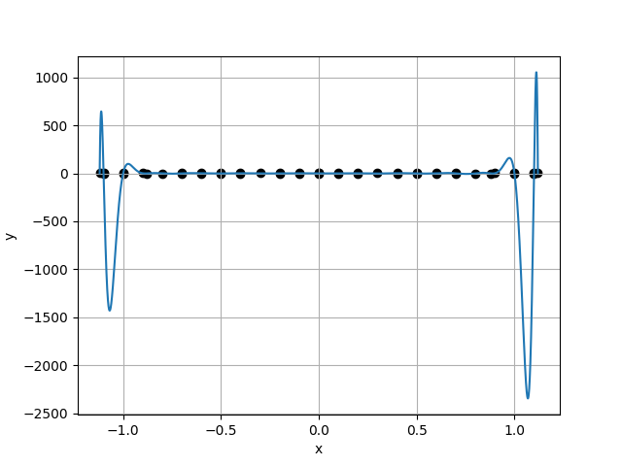
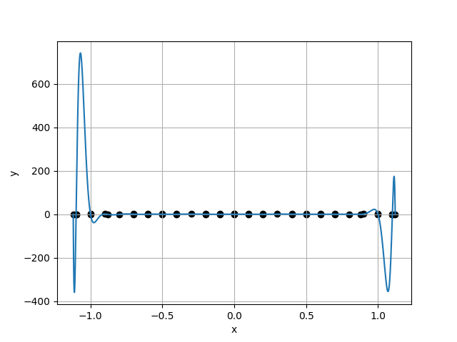
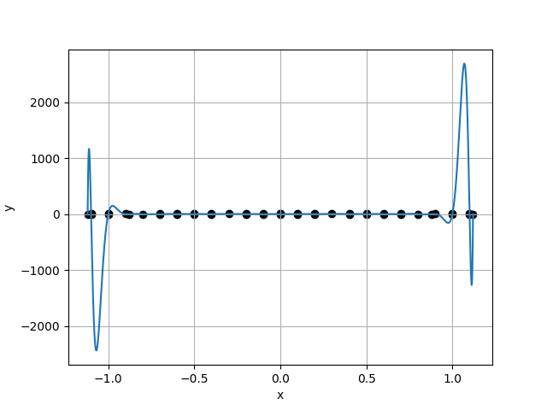
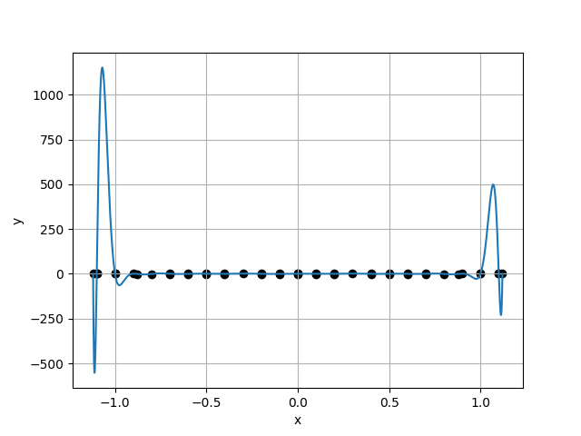
Case 37 :
Case 38 :
f(x) = -6.7346E-01 + -4.0998E+00 * x + 2.5142E+02 * x^2 + 4.2093E+02 * x^3 + -9.7994E+03 * x^4 + -1.2183E+04 * x^5 + 1.3827E+05 * x^6 + 1.5261E+05 * x^7 + -9.3029E+05 * x^8 + -1.0008E+06 * x^9 + 3.2975E+06 * x^10 + 3.7260E+06 * x^11 + -6.1691E+06 * x^12 + -7.9205E+06 * x^13 + 5.6060E+06 * x^14 + 8.5216E+06 * x^15 + -3.7358E+06 * x^16 + -1.3182E+06 * x^17 + 1.0284E+07 * x^18 + -6.5034E+06 * x^19 + -1.9386E+07 * x^20 + 5.1315E+06 * x^21 + 1.3538E+07 * x^22 + 4.6862E+05 * x^23 + -1.9302E+06 * x^24 + -1.2983E+06 * x^25 + 2.0971E+06 * x^26 + -3.0005E+05 * x^27 + -4.3425E+06 * x^28 + 6.3554E+05 * x^29 + 1.0786E+06 * x^30 + -7.1351E+05 * x^31 + 9.2538E+04 * x^32 + 6.2023E+05 * x^33 + 7.6491E+05 * x^34 + -1.8955E+05 * x^35 + -3.9449E+05 * x^36
f(x) = 3.9433E-01 + -4.4027E-01 * x + -6.6610E+01 * x^2 + 7.1898E+01 * x^3 + 2.7819E+03 * x^4 + -2.5055E+03 * x^5 + -3.8938E+04 * x^6 + 3.3734E+04 * x^7 + 2.6420E+05 * x^8 + -2.2485E+05 * x^9 + -9.8661E+05 * x^10 + 8.2471E+05 * x^11 + 2.0743E+06 * x^12 + -1.7334E+06 * x^13 + -2.1911E+06 * x^14 + 2.1262E+06 * x^15 + 2.6150E+05 * x^16 + -1.7137E+06 * x^17 + 2.0592E+06 * x^18 + 1.3148E+06 * x^19 + -2.4072E+06 * x^20 + -6.0764E+05 * x^21 + 1.1699E+06 * x^22 + -6.0230E+05 * x^23 + 1.7939E+04 * x^24 + 1.8656E+05 * x^25 + -2.0525E+05 * x^26 + 1.0827E+06 * x^27 + -5.7547E+05 * x^28 + -3.0423E+05 * x^29 + 9.1493E+05 * x^30 + -5.8547E+05 * x^31 + -2.9081E+05 * x^32 + -2.4647E+05 * x^33 + -1.4437E+05 * x^34 + 6.8848E+05 * x^35 + 7.5083E+04 * x^36 + -2.3664E+05 * x^37
2.6093E+00
1.8636E+00
1.4001E+00
8.4434E-01
Case 39 :
f(x) = 5.6913E-01 + 6.0009E+00 * x + -1.1911E+02 * x^2 + -7.8775E+02 * x^3 + 4.9206E+03 * x^4 + 2.5680E+04 * x^5 + -7.0725E+04 * x^6 + -3.4099E+05 * x^7 + 4.9618E+05 * x^8 + 2.3011E+06 * x^9 + -1.9148E+06 * x^10 + -8.6843E+06 * x^11 + 4.1285E+06 * x^12 + 1.8752E+07 * x^13 + -4.3403E+06 * x^14 + -2.1842E+07 * x^15 + 2.0791E+05 * x^16 + 1.0181E+07 * x^17 + 4.0332E+06 * x^18 + 2.0180E+06 * x^19 + -2.7294E+06 * x^20 + -7.3228E+05 * x^21 + -7.6503E+05 * x^22 + -3.4352E+06 * x^23 + 1.1584E+06 * x^24 + 2.8657E+06 * x^25 + -7.8306E+05 * x^26 + -2.3665E+06 * x^27 + 1.4849E+06 * x^28 + 3.0968E+05 * x^29 + -8.8822E+05 * x^30 + 1.2287E+06 * x^31 + -6.2317E+05 * x^32 + 1.4146E+06 * x^33 + 9.4407E+05 * x^34 + -2.5611E+06 * x^35 + -4.0654E+05 * x^36 + 8.6604E+05 * x^37 + 6.3381E+04 * x^38
Case 40 :
f(x) = 6.2698E-01 + -7.0891E-01 * x + -1.3526E+02 * x^2 + 6.5203E+01 * x^3 + 5.4777E+03 * x^4 + -1.6809E+03 * x^5 + -7.6594E+04 * x^6 + 1.8008E+04 * x^7 + 5.1542E+05 * x^8 + -9.1305E+04 * x^9 + -1.8747E+06 * x^10 + 1.9440E+05 * x^11 + 3.7392E+06 * x^12 + 9.6956E+04 * x^13 + -3.6437E+06 * x^14 + -1.3247E+06 * x^15 + 7.0917E+05 * x^16 + 2.5332E+06 * x^17 + 1.1000E+06 * x^18 + -1.6652E+06 * x^19 + 6.5810E+04 * x^20 + -4.4381E+05 * x^21 + -6.7730E+05 * x^22 + 8.1150E+05 * x^23 + 3.8165E+05 * x^24 + 1.1925E+05 * x^25 + -7.3100E+05 * x^26 + -3.0311E+05 * x^27 + 3.2821E+05 * x^28 + 1.5579E+05 * x^29 + 9.1485E+04 * x^30 + -1.3099E+05 * x^31 + 4.3961E+05 * x^32 + 2.8589E+03 * x^33 + -3.4869E+05 * x^34 + -4.7385E+04 * x^35 + -1.2790E+05 * x^36 + 1.2876E+05 * x^37 + 1.0391E+05 * x^38 + -5.2573E+04 * x^39
2.2072E+00
2.2566E+00
9.7811E-01
9.1611E-01

Slide 11
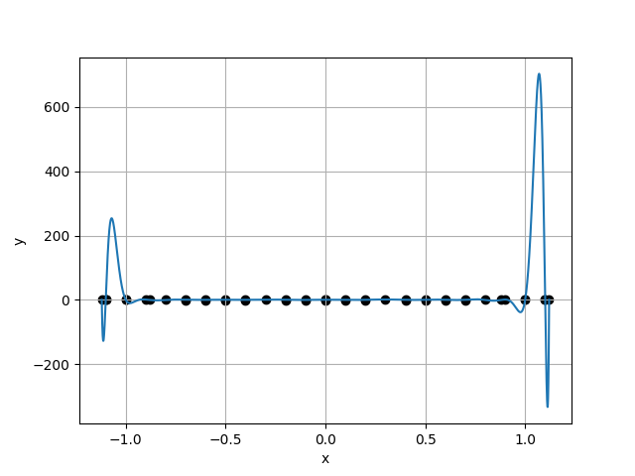
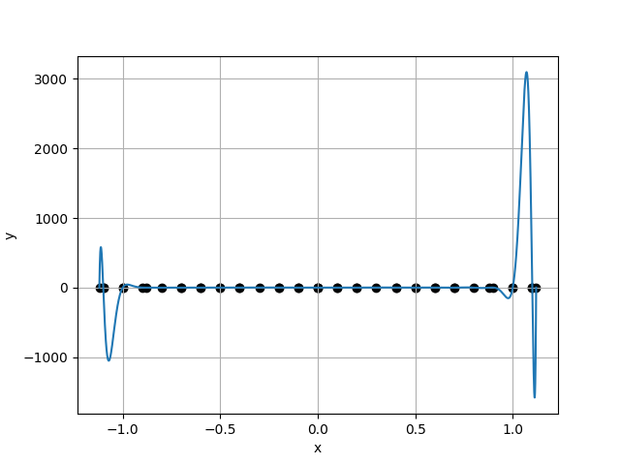
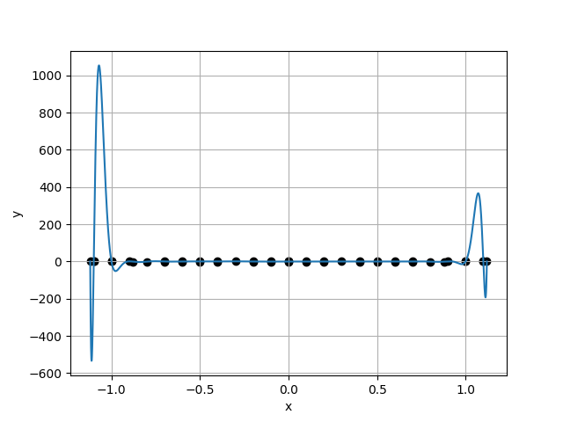
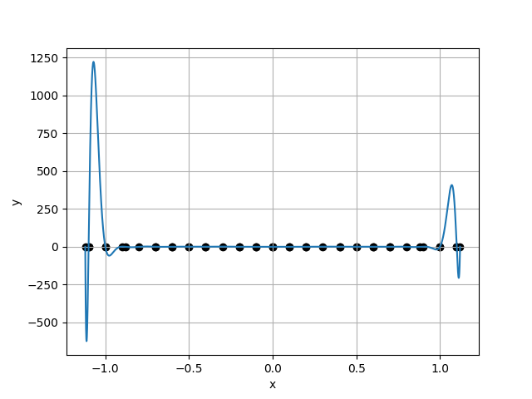
Case 41 :
Case 42 :
f(x) = 4.2941E-01 + 1.2360E+00 * x + -7.6610E+01 * x^2 + -1.2043E+02 * x^3 + 3.1445E+03 * x^4 + 3.3225E+03 * x^5 + -4.3243E+04 * x^6 + -3.9432E+04 * x^7 + 2.8493E+05 * x^8 + 2.4068E+05 * x^9 + -1.0164E+06 * x^10 + -8.0427E+05 * x^11 + 2.0085E+06 * x^12 + 1.4089E+06 * x^13 + -2.0463E+06 * x^14 + -8.7081E+05 * x^15 + 8.1180E+05 * x^16 + -8.8569E+05 * x^17 + -8.7619E+04 * x^18 + 1.4373E+06 * x^19 + 2.3014E+05 * x^20 + -3.6413E+04 * x^21 + 1.6327E+05 * x^22 + -5.2392E+05 * x^23 + -2.1977E+05 * x^24 + -1.5383E+05 * x^25 + -3.8097E+05 * x^26 + -1.5825E+03 * x^27 + -1.6278E+04 * x^28 + 3.0461E+05 * x^29 + 4.5278E+05 * x^30 + 1.0405E+05 * x^31 + 4.9375E+04 * x^32 + -1.7098E+05 * x^33 + -1.9717E+05 * x^34 + -9.9488E+04 * x^35 + -4.8527E+04 * x^36 + 1.0647E+05 * x^37 + 5.0273E+04 * x^38 + -1.8864E+04 * x^39 + 2.1693E+03 * x^40
f(x) = 6.0848E-01 + 1.9114E+00 * x + -1.2872E+02 * x^2 + -1.4238E+02 * x^3 + 5.1596E+03 * x^4 + 2.9083E+03 * x^5 + -7.0728E+04 * x^6 + -2.2133E+04 * x^7 + 4.6055E+05 * x^8 + 4.1471E+04 * x^9 + -1.5796E+06 * x^10 + 3.1121E+05 * x^11 + 2.7764E+06 * x^12 + -1.9482E+06 * x^13 + -1.7303E+06 * x^14 + 4.2582E+06 * x^15 + -1.4512E+06 * x^16 + -3.1804E+06 * x^17 + 2.0908E+06 * x^18 + -1.6970E+06 * x^19 + 3.9061E+05 * x^20 + 2.1510E+06 * x^21 + -6.9339E+05 * x^22 + 2.5499E+06 * x^23 + -7.8020E+05 * x^24 + -2.0640E+06 * x^25 + 3.9364E+05 * x^26 + -1.6551E+06 * x^27 + 2.7660E+05 * x^28 + 8.5895E+05 * x^29 + 1.0311E+04 * x^30 + 3.8722E+04 * x^31 + -3.6001E+05 * x^32 + 6.2374E+05 * x^33 + 5.6303E+05 * x^34 + 3.0374E+05 * x^35 + -2.8785E+05 * x^36 + -6.6952E+05 * x^37 + -8.9691E+04 * x^38 + -3.7829E+04 * x^39 + 7.6006E+04 * x^40 + 1.3429E+05 * x^41
2.4633E+00
2.9062E+00
8.4758E-01
8.3514E-01
Case 43 :
f(x) = 3.8921E-01 + -8.1722E-01 * x + -6.4245E+01 * x^2 + 8.4567E+01 * x^3 + 2.6250E+03 * x^4 + -2.4150E+03 * x^5 + -3.5154E+04 * x^6 + 2.9155E+04 * x^7 + 2.2159E+05 * x^8 + -1.7920E+05 * x^9 + -7.3228E+05 * x^10 + 5.9999E+05 * x^11 + 1.2330E+06 * x^12 + -1.0588E+06 * x^13 + -7.3079E+05 * x^14 + 7.2016E+05 * x^15 + -5.5599E+05 * x^16 + 4.3272E+05 * x^17 + 6.7462E+05 * x^18 + -7.8909E+05 * x^19 + 3.1206E+05 * x^20 + 8.9329E+03 * x^21 + -4.1813E+05 * x^22 + 2.3175E+05 * x^23 + -1.8326E+04 * x^24 + 4.2846E+04 * x^25 + 1.6464E+05 * x^26 + 1.1324E+05 * x^27 + -3.1783E+05 * x^28 + -1.1544E+05 * x^29 + 6.4043E+04 * x^30 + -9.0226E+04 * x^31 + 2.2250E+05 * x^32 + 3.3696E+04 * x^33 + -2.4728E+04 * x^34 + 4.5565E+03 * x^35 + -2.3948E+04 * x^36 + 1.4164E+04 * x^37 + -4.2130E+04 * x^38 + 1.9563E+04 * x^39 + -2.0889E+04 * x^40 + -1.5684E+04 * x^41 + 2.5129E+04 * x^42
Case 44 :
f(x) = 4.2987E-01 + -7.3845E-01 * x + -7.6541E+01 * x^2 + 7.0546E+01 * x^3 + 3.1254E+03 * x^4 + -1.9064E+03 * x^5 + -4.2553E+04 * x^6 + 2.1999E+04 * x^7 + 2.7547E+05 * x^8 + -1.2886E+05 * x^9 + -9.5084E+05 * x^10 + 4.0378E+05 * x^11 + 1.7479E+06 * x^12 + -6.2848E+05 * x^13 + -1.4061E+06 * x^14 + 2.3582E+05 * x^15 + -2.0544E+05 * x^16 + 5.9671E+05 * x^17 + 9.3864E+05 * x^18 + -6.9962E+05 * x^19 + -2.1126E+05 * x^20 + 1.0461E+05 * x^21 + -2.1458E+05 * x^22 + 5.5865E+04 * x^23 + 2.2368E+05 * x^24 + 7.9305E+03 * x^25 + -1.6124E+05 * x^26 + 5.4487E+04 * x^27 + -1.4674E+05 * x^28 + 1.0014E+05 * x^29 + -5.1961E+04 * x^30 + -9.6740E+04 * x^31 + 2.6937E+05 * x^32 + -3.6130E+04 * x^33 + 6.6121E+04 * x^34 + -8.1214E+04 * x^35 + -1.0917E+05 * x^36 + 9.3550E+04 * x^37 + -3.8852E+04 * x^38 + 2.1968E+04 * x^39 + -9.3592E+03 * x^40 + -2.2388E+04 * x^41 + 2.3926E+04 * x^42 + -1.5905E+03 * x^43
3.4799E+00
4.9243E+00
7.0669E-01

